Slide 1
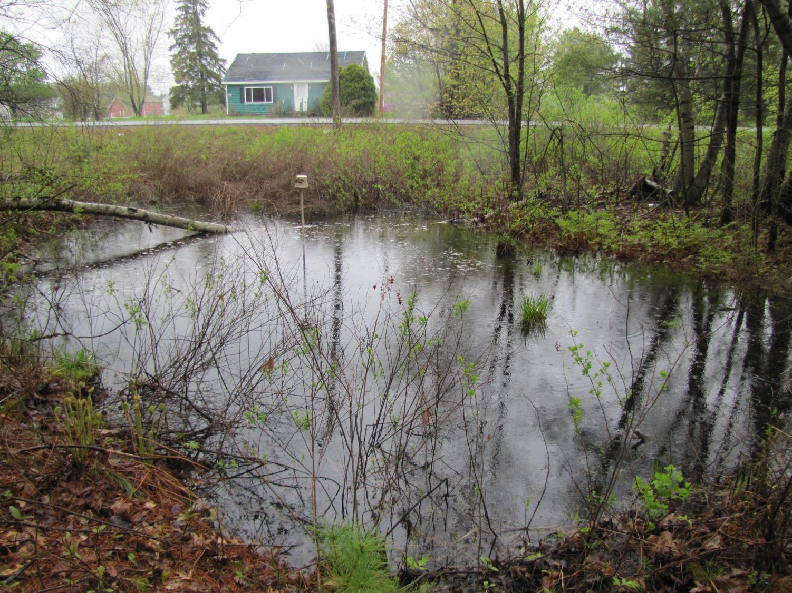
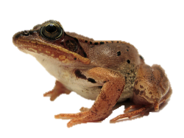
Wood frog tadpole health and survival along an urbanization gradient Carly Eakin March 31, 2016
Notes:
Focus of PhD is on pool breeding amph response to urbanization
At UMaine under the direction of Aram and Mac at UMaine.
1st, Acknowledge and thank …not least of which …MAWS 2015 Research Stipend
“WF tadpole health and survival along an urbanization gradient”
Present some of the preliminary results to come

Slide 2
Context
Human Land Use Decisions
Individual health & Short-term survival
Persistence
(Population)
Notes:
Provide context for my work
Land use decisions (urbanization)→ habitat → individual health and short term processes → indicate and predict pop response
B/c this is linked to pop persistence, can be used to refine land use strategies aligned with ensuring pop persistence

Slide 3
Question & Study Area
How does health and survival differ along a human disturbance gradient?
Predict how site conditions →
Approximately 40 pools
Bangor
Notes:
For this part of my study, I’m interested in

Slide 4
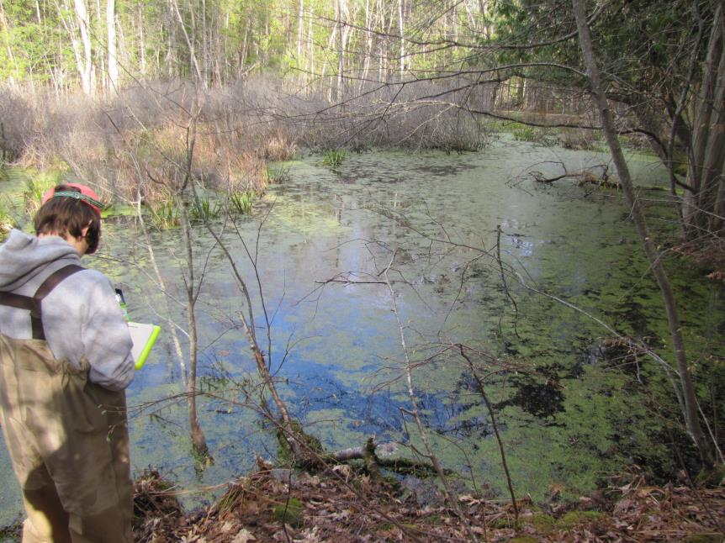
Characterize sites
Vegetation

Slide 5
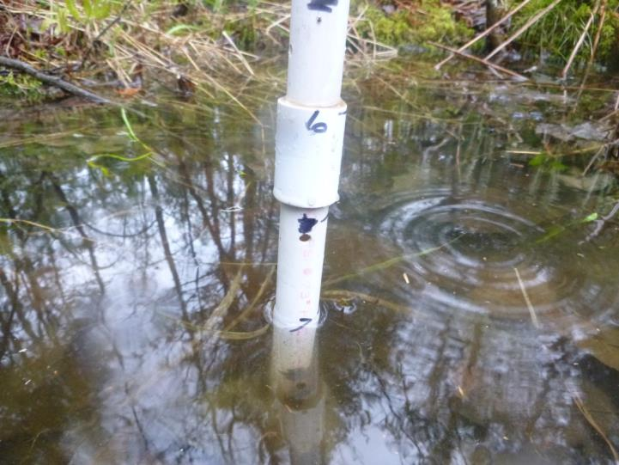
Characterize sites
Hydrologic conditions
Notes:
Hydroperiod
Temp

Slide 6
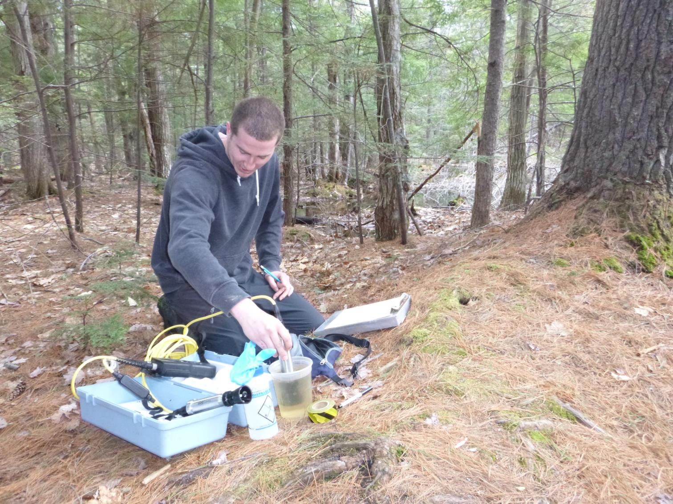
Characterize sites
Specific conductivity (salt)
Dissolved oxygen

Slide 7
Characterize sites
% Impervious surface at 90, 300, 600, and 990 m radii

Slide 8
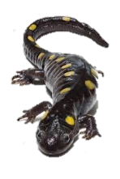
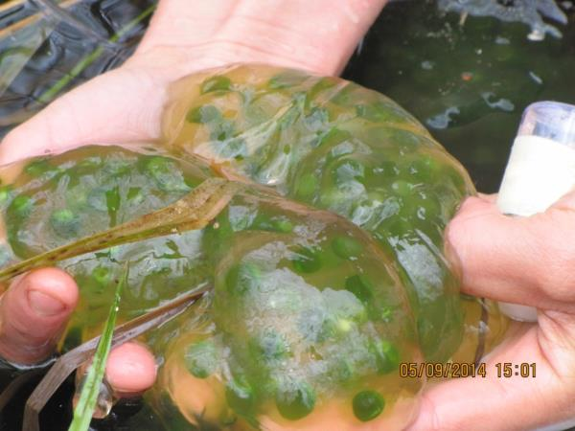
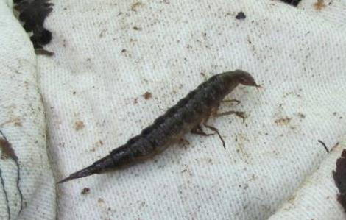
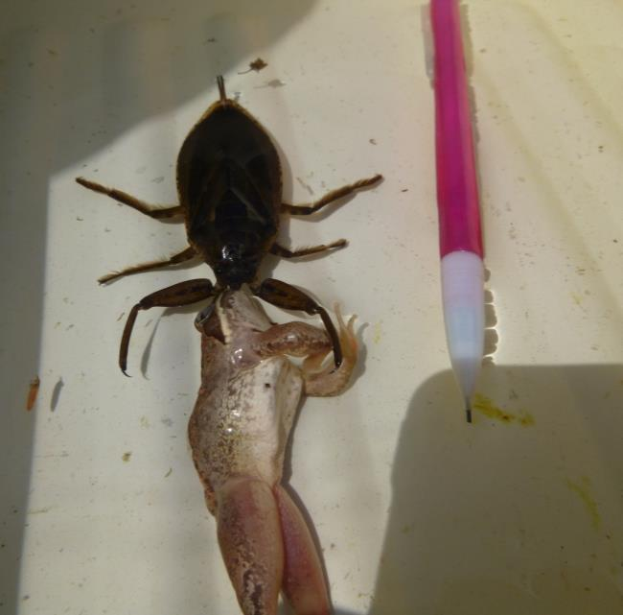
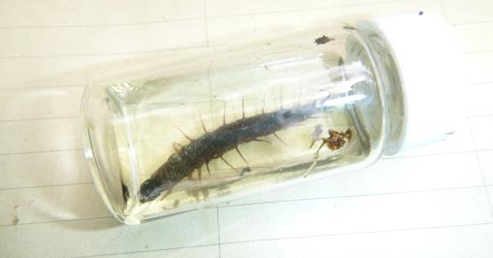
Characterize sites
Predator surveys
Notes:
2015 only

Slide 9
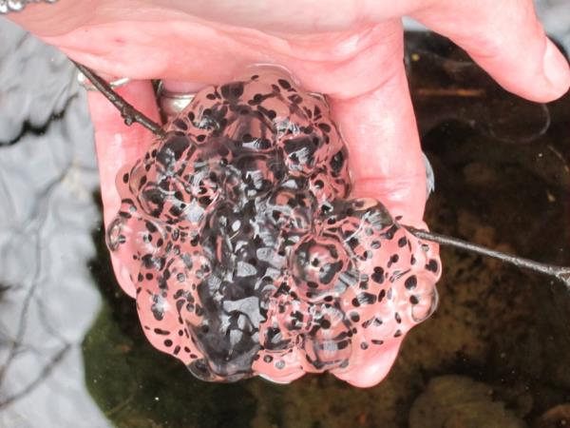
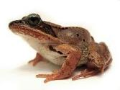
Measure tadpole survival
Metamorphs : Egg masses = Relative larval survival
Egg mass counts

Slide 10
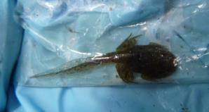
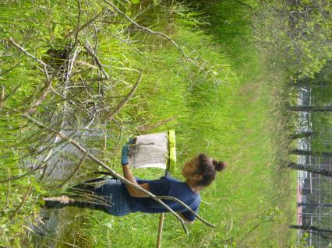
Measure tadpole survival
Metamorphs : Egg masses = Relative larval survival
Dip netting for abundance
Notes:
Assumed that tadpoles about to complete metamorphosis would likely emerge as froglets
Kept an eye on pools (stage 40-41)

Slide 11
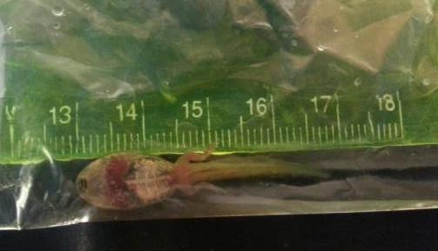
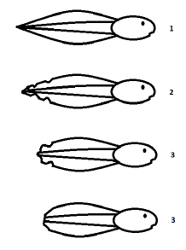
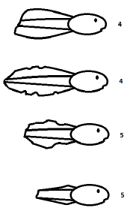
Examine tadpole health
Weekly health surveys
Signs of Disease
Mass
SVL
Tail Length
Tail Fin Height
Tail Damage
Developmental Stage
Shulse 2011
Pool-wide condition
PC1: Size
PC2: Development rate
PC3: Tail Damage
Shulse 2011
Notes:
Weekly
5,000+ tadpoles
But there is no single “condition” variable (ideal for modeling):
multivariate PCA to reduce variables; ask me later to explain in detail

Slide 12
Predict body condition and survival
Pool-wide responses
Size
Development rate
Tail Damage
Survival
=
water chemistry + hydrology + land cover
+ vegetation + predators + competitors
2014 Global Model
Response = Salt + Impervious 990 m + Hydroperiod + Water temp + Canopy + WF egg m⁻²+ SS egg m⁻²
2015 Global Model
Response = Salt + Impervious 990 m + Hydroperiod + Water temp + Canopy + WF egg m⁻²+ SS egg m⁻² + invert predator m⁻²
Shulse 2011
AICc: best model and variable reduction
Notes:
As I mentioned, we wanted to predict condition and survival based on site chars
Reduced number of site conditions vars (highly correlated)

Slide 13
Predict body condition and survival
Response | Dataset | Imp 990 m | Salt | WF Density | SS Density | Invert Pred Density | Canopy | Water Temp | Hydro
Size | 2014 | + | + | - | + |  | + | + | +
 | 2015 | - | + | - | - | - | - | - | +
Development Rate | 2014 | - | + | - | + |  | - | - | -
 | 2015 | + | + | - | - | - | - | + | -
Tail Damage | 2014 | - | - | - | - |  | - | + | -
 | 2015 | - | - | - | + | + | + | + | +
Relative Larval Survival | 2014 | - | - | - | - |  | + | - | +
 | 2015 | + | + | + | - | - | - | + | +
Notes:
No best model → skip to broad pattern examination
Coefficient values of model averaged parameters – indicate response, year, and +/- are influence on response variable
Shows influence of variables on response
Check consistency between years

Slide 14
Predict body condition and survival
Response | Dataset | Imp 990 m | Salt | WF Density | SS Density | Invert Pred Density | Canopy | Water Temp | Hydro
Size | 2014 | + | + | - | + |  | + | + | +
 | 2015 | - | + | - | - | - | - | - | +
Development Rate | 2014 | - | + | - | + |  | - | - | -
 | 2015 | + | + | - | - | - | - | + | -
Tail Damage | 2014 | - | - | - | - |  | - | + | -
 | 2015 | - | - | - | + | + | + | + | +
Relative Larval Survival | 2014 | - | - | - | - |  | + | - | +
 | 2015 | + | + | + | - | - | - | + | +
Size
Long hydroperiod → long time for growth
Predators and competitors reduce foraging/food available
Development
Salt creates harsh conditions
Notes:
Examples of expected patterns:

Slide 15
Predict body condition and survival
Response | Dataset | Imp 990 m | Salt | WF Density | SS Density | Invert Pred Density | Canopy | Water Temp | Hydro
Size | 2014 | + | + | - | + |  | + | + | +
 | 2015 | - | + | - | - | - | - | - | +
Development Rate | 2014 | - | + | - | + |  | - | - | -
 | 2015 | + | + | - | - | - | - | + | -
Tail Damage | 2014 | - | - | - | - |  | - | + | -
 | 2015 | - | - | - | + | + | + | + | +
Relative Larval Survival | 2014 | - | - | - | - |  | + | - | +
 | 2015 | + | + | + | - | - | - | + | +
Tail Damage
Predators increase damage
Greater density of tadpoles reduce pressure
Relative Survival
Predator density reduces survival
Notes:
Examples of expected patterns:

Slide 16
Predict body condition and survival
Response | Dataset | Imp 990 m | Salt | WF Density | SS Density | Invert Pred Density | Canopy | Water Temp | Hydro
Size | 2014 | + | + | - | + |  | + | + | +
 | 2015 | - | + | - | - | - | - | - | +
Development Rate | 2014 | - | + | - | + |  | - | - | -
 | 2015 | + | + | - | - | - | - | + | -
Tail Damage | 2014 | - | - | - | - |  | - | + | -
 | 2015 | - | - | - | + | + | + | + | +
Relative Larval Survival | 2014 | - | - | - | - |  | + | - | +
 | 2015 | + | + | + | - | - | - | + | +
Size
Positively influenced by road salt
Tail Damage
Reduced by salt
Salt → increased tadpole mortality → more food for survivors
Salt → predator → tadpoles
Notes:
Salt influences tadpoles indirectly via predators
Suggested positive influence by

Slide 17
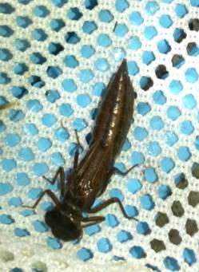
2016 Research
Lab experiments
Road salt
Predators
Food availability
Notes:
Test parameter influences with lab manipulations in 2016 → understand mechanisms driving field observed patterns

Slide 18
Examine tadpole health
Weekly health surveys
Signs of Disease
Mass
SVL
Tail Length
Tail Fin Height
Tail Damage
Developmental Stage
Shulse 2011
Shulse 2011

Slide 19
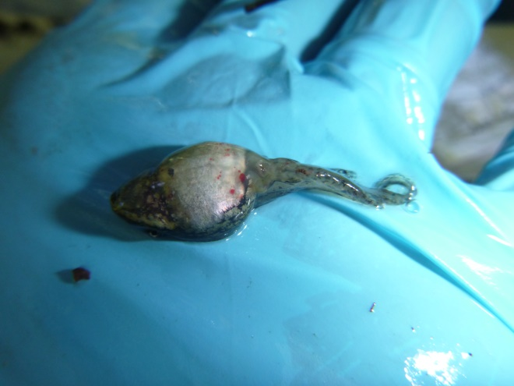
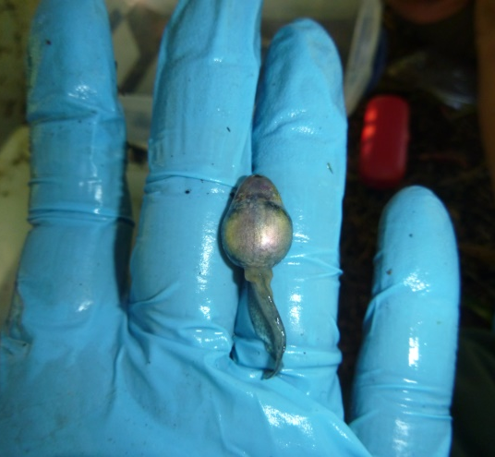
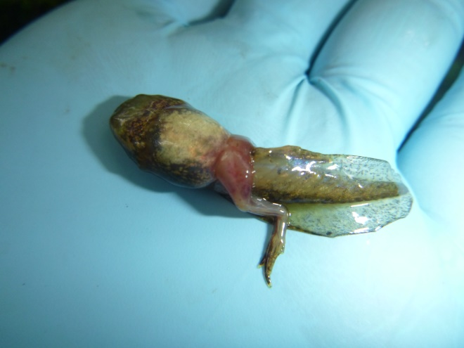
Signs of disease
Ranavirus
Tadpoles in >½ of pools with clinical signs
4 pools with die-offs

Slide 20
Signs of disease
Ichthyophonus
9 pools, 96 individuals
In 3/4 pools with ranavirus die-offs
Unknown conditions correlating with infection

Slide 21
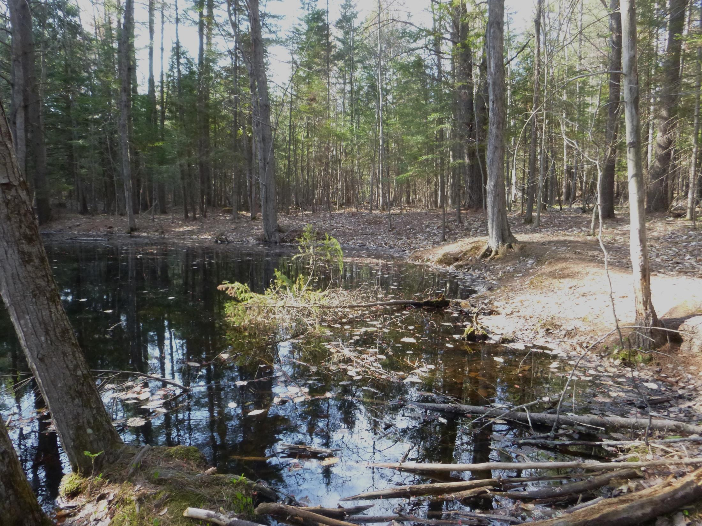
Ranavirus/Ichthyophonus surveillance study
5 pools, weekly monitoring and collection
Site condition influence on infection timing
Die offs
Lab testing
Lab experiment

Slide 22
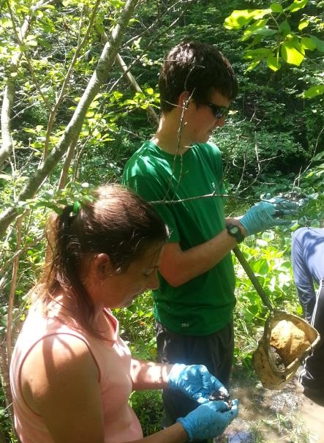
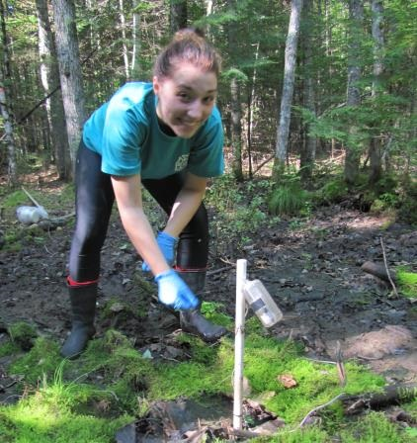
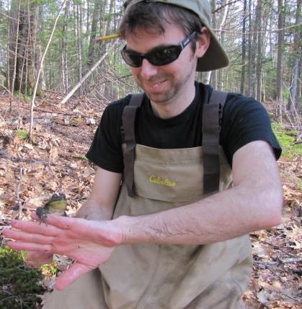
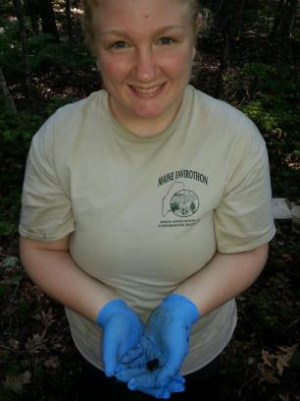
Acknowledgments
Field Techs
Diane Dunham
Annika Gallandt
Lara Katz
Samantha McGarrigle
Emma Betterley-Dow
Tom Hastings
Luke Wotton
Hope Eye
Ryo Nakagawa
Support
Chadrick Eakin
Kris Hoffmann
Britt Cline
Luke Groff
Mitchell Jones
Jared Homola
Lydia Kifner
Laura Podzikowski
Jessica Balukas
George Maynard
Andy O’Malley
Brianne Du Clos
Abdulai Barrie
Sean Rue
Land owners
Committee
Malcolm Hunter
Aram Calhoun
Rebecca Holberton
Hamish Greig
Mike Kinnison
Faculty/Technical Advice
Lynda Leppert
Anne Lichtenwalner
Cyndy Loftin
Joe Zydlewski
Joyce Longcore
Krista Capps

Slide 23
Questions?
Carly.Eakin@gmail.com

