Slide 1
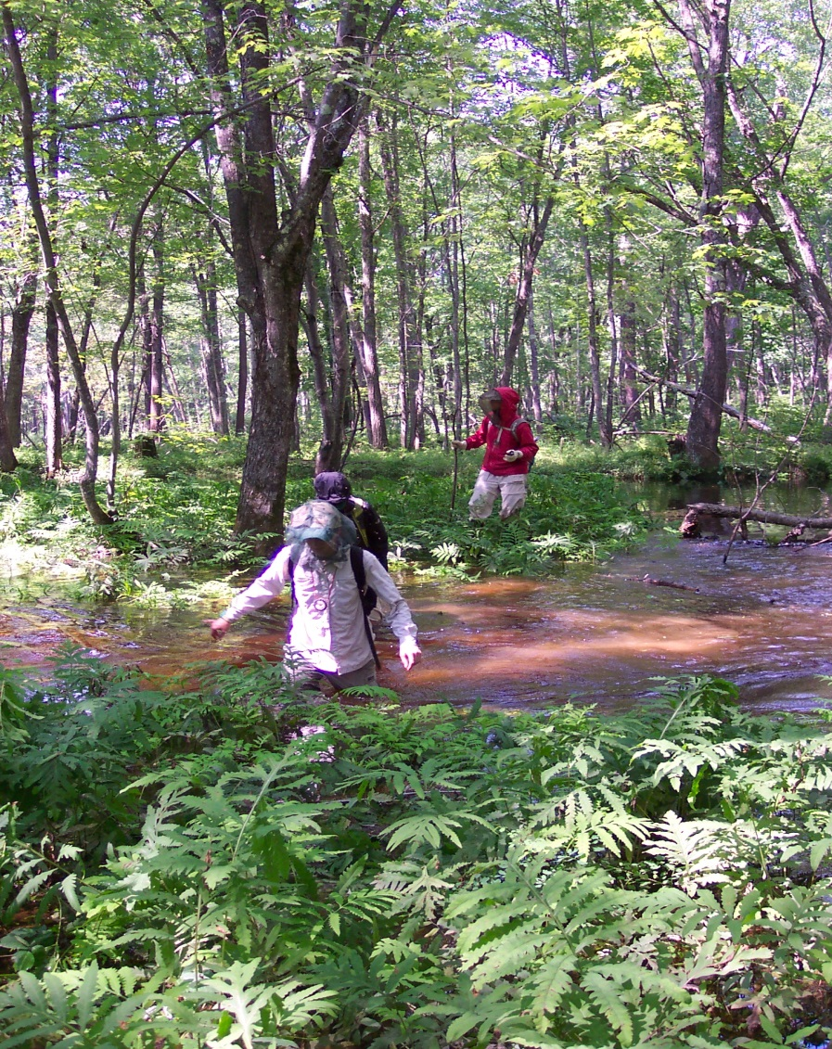

Ecological Integrity Assessment of Maine Wetlands
Andy Cutko
Maine Natural Areas Program
March 2016

Slide 2
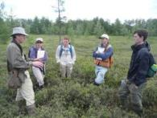





Topics to Be Covered
Background on Ecological Integrity Assessment
Development of EIA for use in Maine
A Tale of Two Swamps - Real Life Examples!
Take Home Messages
Notes:
True collaborative project - Don FL and Bill Nichols, funded by EPA

Slide 3
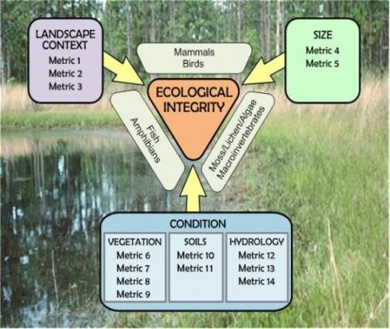
What is Ecological Integrity Assessment?
A set of indicators of ecosystem structure, function, and composition
Emphasis on range of natural variation – and what’s outside it!
Ensure links with management/restoration needs
National protocols, currently being used in NH, NY, NJ, CO, WA, MI, NM
Notes:
In the NatureServe approach, EI is assessed through a set of …
Bullet 3 – idea is to use in both wetland protection and restoration
Three Pillars – size, condition, LC
Currently being used by New Hampshire, New Jersey, NY, Colorado, Washington, New Mexico, others

Slide 4
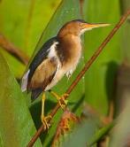
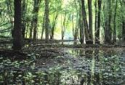
Wetland Assessments:
Functions, Values, and Integrity
Conservation
Status/
Irreplaceability
Functional
Measures
Ecological Integrity
Measures
Ecosystem Services
Condition / Integrity
Conservation Values
Notes:
There are a number of approaches and perspectives and wetland assessment and classification. Traditionally, heritage programs focus on VALUES – (left side) rarity, size, uniqueness, irreplaceability – while some regulatory approaches focus more on FUNCTIONS – floodflow alteration, water quality enhancement. EIA combines elements of both.

Slide 5
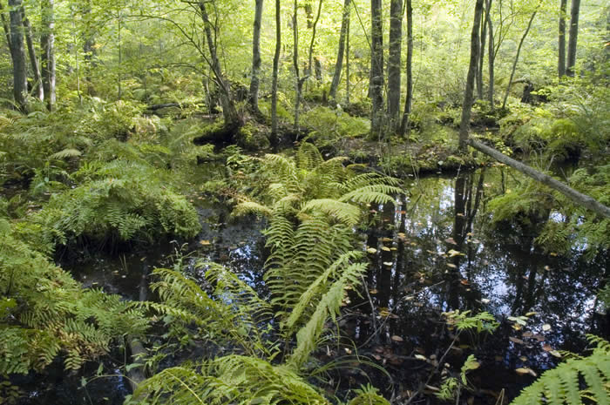
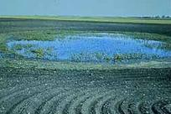
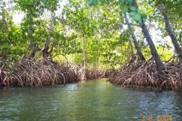
Topics to Be Covered
Background on EIA
Development of EIA for use in Maine
A Tale of Two Forests - Real Life Examples!
Take Home Messages
Notes:
About three years ago our program received a grant from EPA… to apply EIA methods to Maine.
One of the challenges is to adapt a national model to ME, when the national model is meant to apply to wetlands ranging from Prairie Potholes to North Carolina Pocosins.

Slide 6
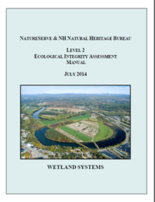
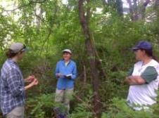
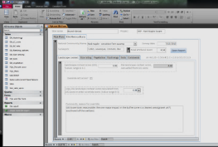
EIA in Maine: Accomplishments to Date
Reviewed protocols and manuals from NatureServe, NH, and others
Field tested EIA methods (and FQA) on 70+ floodplain forests and red maple swamps
Developed relational database to store, process data
Adapting protocols and manual for Maine use

Slide 7
Topics to Be Covered
Background on EIA
Development of EIA for use in Maine
A Tale of Two Forests - Real Life Examples!
Take Home Messages

Slide 8
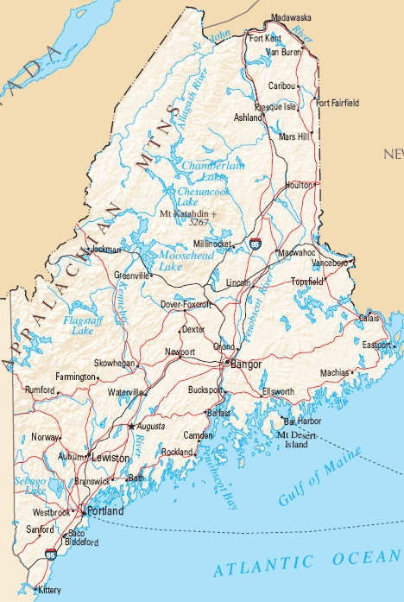
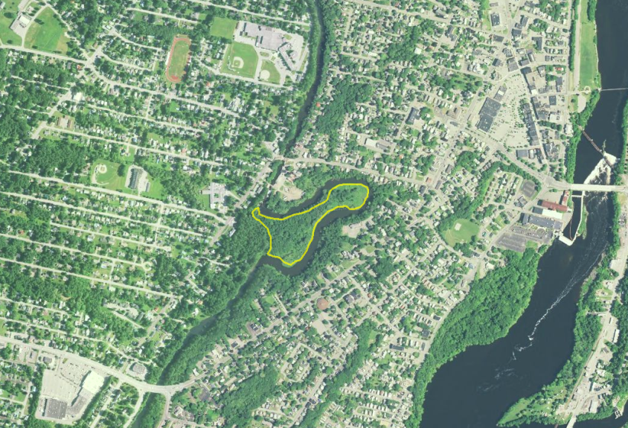
Messalonskee Stream
Waterville Maine
Hardwood River Terrace Forest
Size: 11 ac
Size Rank = C
Notes:
Small site in central Maine – one of the few areas in Maine that would truly be called urban. Some historic loss at southwestern side.

Slide 9
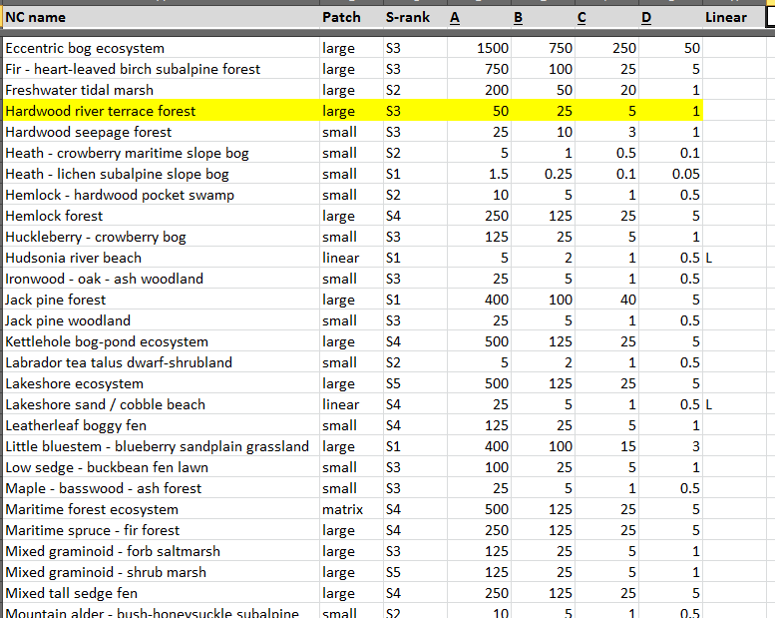
Size Ranks for Maine Natural Communities (Acres)
Notes:
Sizes are generally in line with NS guidelines on patch size – small, large, matrix – the way natural communities lie on the landscape.

Slide 10
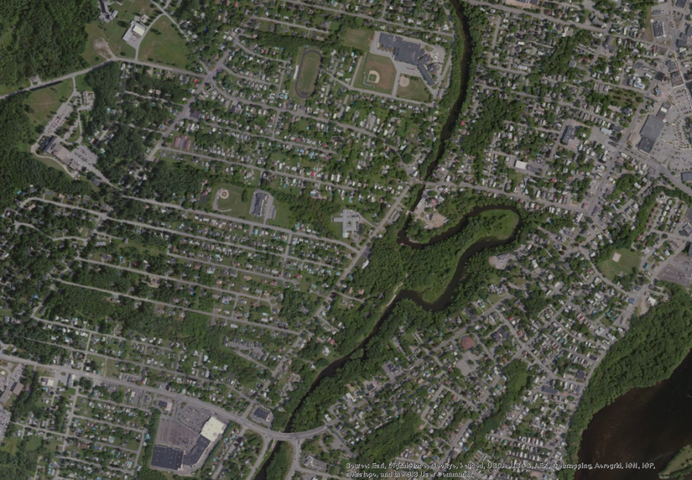
Condition
Vegetation
Composition
Regeneration
Invasive Cover
Structure
Hydrology
Water source
Hydroperiod
Connectivity
Soils
Disturbance
Physical patch diversity

Slide 11
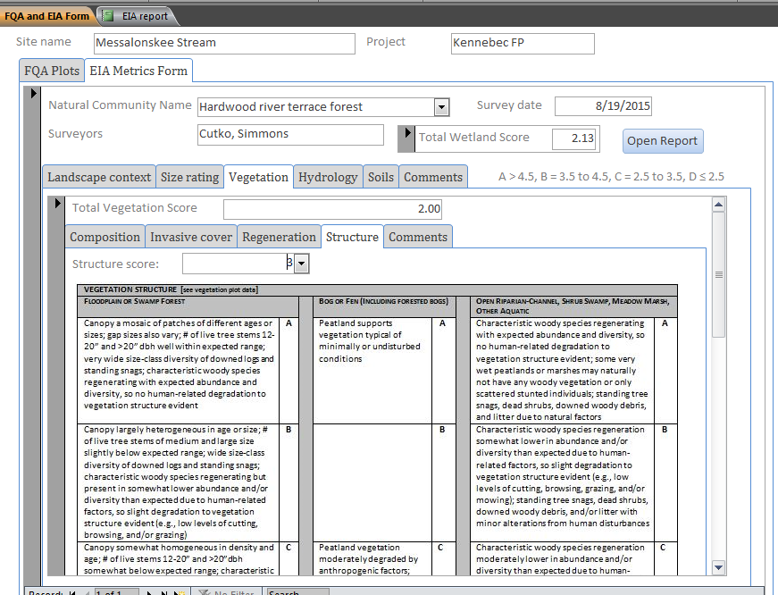
Notes:
We’ve taken language on metrics and thresholds from NH.

Slide 12
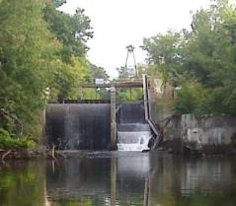
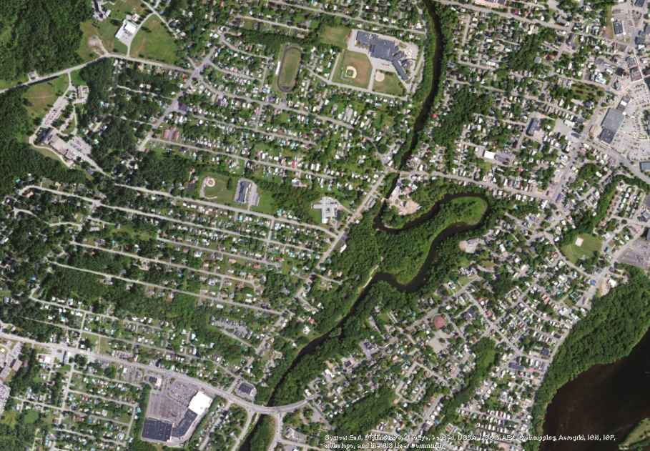
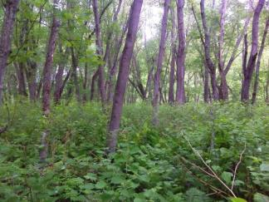
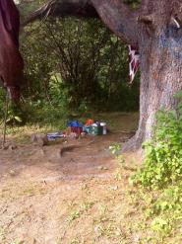

Hydrology
Condition
Vegetation
Soil
Weighted coefficent of conservatism = 1.29
Notes:
100 year old dam immediately upstream has altered hydrology; one of lowest WCoC values encountered in floodplain forests.

Slide 13
Stressors Checklist
Notes:
Can be used in a quantiative or scoring fashion as ancillary data, or just as a list of things to consider in evaluating the site and landscape context.

Slide 14
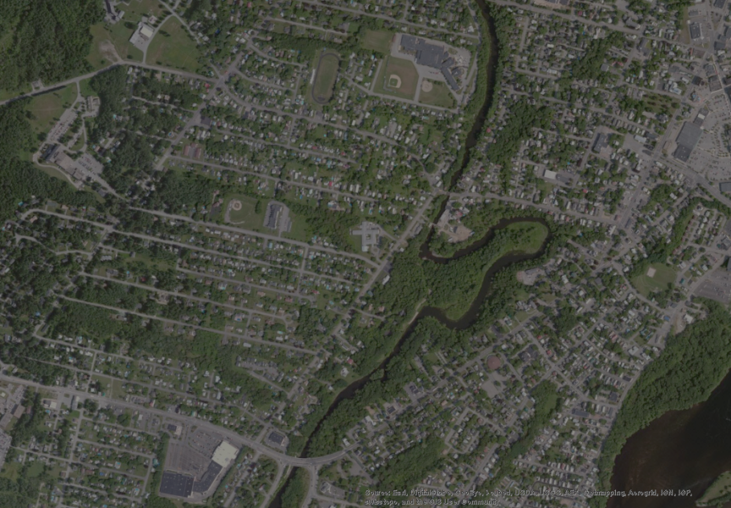
Condition = D (2.6)
Vegetation 2.0
Composition D (1)
Regeneration C (3)
Invasive Species D (1)
Structure C (3)
Hydrology 2.0
Water source D (1)
Hydroperiod D (1)
Connectivity B (4)
Soils 3.0
Disturbance C (3)
Physical patch diversity C (3)
Notes:
Connectivity – refers to immediate connectivity between FP forest and water – some areas of rip-rap but largely connected.

Slide 15
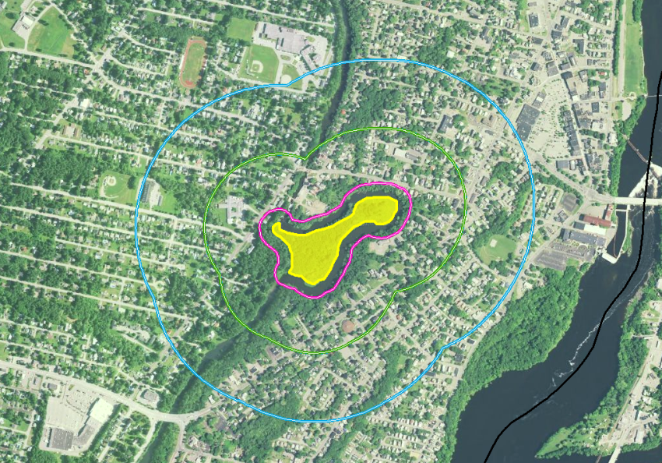
Landscape Context
50
250
500
Notes:
Buffer –
Surrounding land use
Landscape Connectivity
Created a GIS tool USING WHAT COVER???

Slide 16
Land Use Index
Using Land cover data in a GIS:
Each cover type is assigned a coefficient value
Current Land Use | Coefficient
Paved roads / parking lots / domestic or commercially developed buildings / mining (gravel pit, quarry, open pit, strip mining) | 0
Unpaved roads (e.g., driveway, tractor trail) / abandoned mines | 0.1
Agriculture (tilled crop production) / intensively developed vegetation (golf courses, lawns, etc.) | 0.2
Vegetation conversion (chaining, cabling, rotochopping, clearcut) | 0.3
Heavy grazing on rangeland or pastures | 0.3
Heavy logging or tree removal with 50-75% of trees >30 cm dbh removed | 0.4
Intense recreation (ATV use / camping / sport fields / popular fishing spot, etc.) / military training areas (armor, mechanized) | 0.4
Agriculture - permanent crop (vineyards, orchards, nurseries, berry production, introduced hay field and pastures, etc.) | 0.4
Commercial tree plantations / Christmas tree farms | 0.5
Dam sites and flood disturbed shorelines around water storage reservoirs | 0.5
Recent old fields and other disturbed fallow lands dominated by ruderal and exotic species | 0.5
Moderate grazing on rangeland | 0.6
Moderate recreation (high-use trail) | 0.7
Mature old fields and other fallow lands with natural composition | 0.7
Selective logging or tree removal with <50% of trees >30 cm dbh removed | 0.8
Light grazing / light recreation (low-use trail) / haying of native grassland | 0.9
Natural area / land managed for native vegetation | 1
* Modified from Hauer et al. 2002
Notes:
Paved roads – O to intact forest 1.0

Slide 17
Land Use Index Scoring Table
  Weight of index values in each of the three concentric zones toward overall score…
  Buffer (0-50): 60%
  Surrounding land use (50-250): 25%
  Landscape connectivity (250-500): 15%
  Overall land use index is then assigned a metric rating
Metric Rating (National )
Excellent (A) | Good (B) | Fair (C) | Poor (D)
0.95 - 1.0 | 0.80 - 0.94 | 0.4 - 0.79 | < 0.4

Slide 18
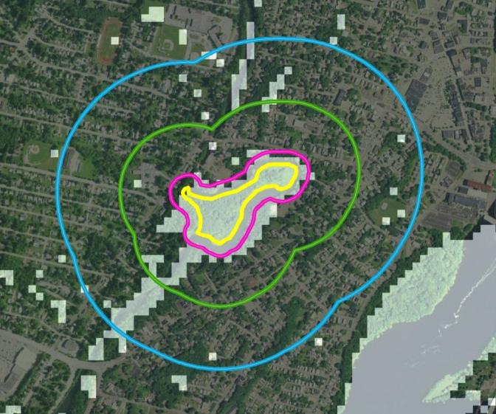
Landscape Context = 0.52 (C)
Notes:
Justin – which land cover layer did we use??

Slide 19
Landscape Context: Manual Override
LC =0.65 (C)

Slide 20
Ecological Integrity Assessment
Overall wetland rank = D (2.13)
Condition Rank = D
Size Rank = C
LC Rank = D
Pre-Field
Condition Rank Specs
Size Rank Specs
LC Rank Specs
Landscape
Context
GIS
Calculation
Condition Metrics
Condition = C
Size Metrics
Size = C
LC Metrics
LC = B
Vegetation
Metric1
Metric2
|
Metric7
Soil/Substrate
Metric1
Metric2
Metric3
Hydrology
Metric1
Metric2
Metric3
General
Form
Metric1 : Relative
Metric2 Absolute
Metric1
Condition
Stressor
Checklist
LC
Stressor
Checklist
Post-Field
EIA Level Rapid Recon Form
Plot data
Field

Slide 21
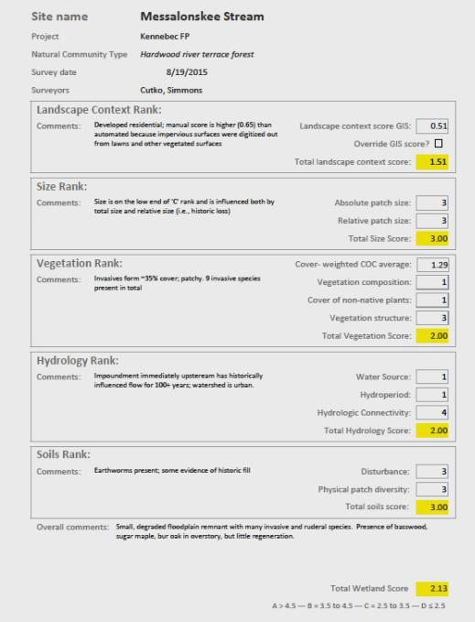
Letter Grades indicate ‘Excellent, Good’ Fair, Poor’
A > 4.5
B = 3.5 – 4.5
C = 2.5 - 3.5
D < 2.5

Slide 22
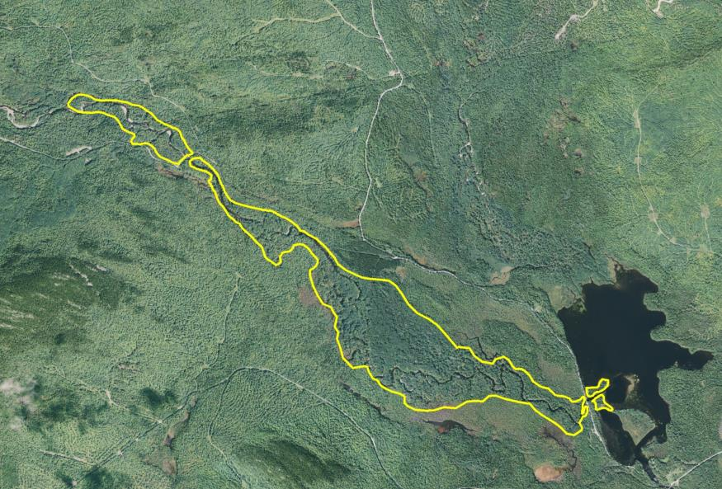
West Branch of the Pleasant River
Silver Maple Floodplain Forests
T6 R9 NWP
Size = 502 Acres (A)

Slide 23
Condition
Vegetation
Hydrology
Soils

Slide 24
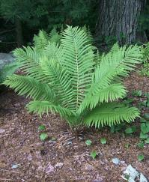
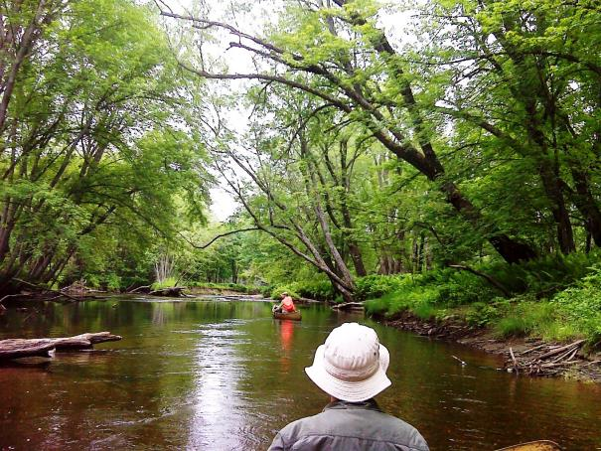
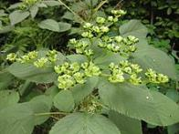
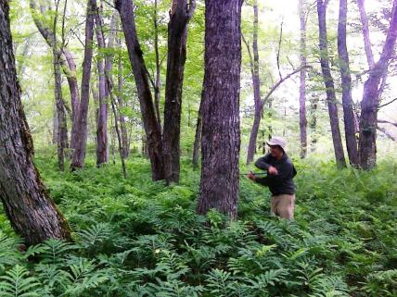
Ostrich fern
Wood nettle
WC = 4.35 (FQI)

Slide 25
Condition = A (4.73)
Vegetation 5.0
Composition A (5)
Regeneration A (5)
Invasive Species A (5)
Structure A (5)
Hydrology 5.0
Water source A (5)
Hydroperiod A (5)
Connectivity A (5)
Soils 4.5
Disturbance B (4)
Physical patch diversity A (5)
Notes:
\

Slide 26
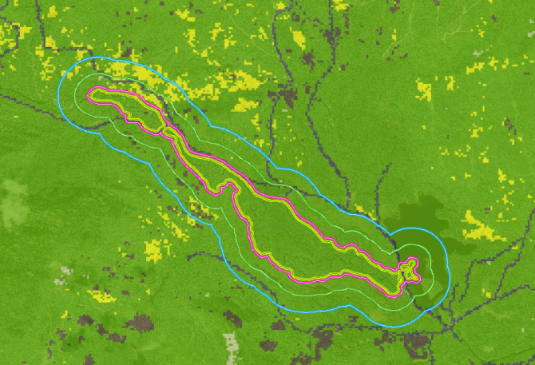
Landscape Context = 0.92 (B)

Slide 27
Ecological Integrity Assessment
Overall wetland system rank = A (4.73)
Condition Rank = A
Size Rank = A
LC Rank = B
Pre-Field
Condition Rank Specs
Size Rank Specs
LC Rank Specs
LC Index
GIS
Calculation
Condition Metrics
Condition = A
Size Metrics
Size = A
LC Metrics
LC = B
Vegetation
Metric1
Metric2
|
Metric4
Soil/Substrate
Metric1
Metric2
Metric3
Hydrology
Metric1
Metric2
Metric3
General
Form
Metric1
Metric2
Metric1
Condition
Stressor
Checklist
LC
Stressor
Checklist
Post-Field
EIA Level Rapid Recon Form
Plot data
Field

Slide 28
EIA: Take Home Messages
EIA provides a more consistent, repeatable method for evaluating wetland condition and conservation value
Work by NatureServe, NH Heritage and others has provided a foundation for use of EIA across the region
Further work is needed to develop a reference set of EIA scores for wetlands to help calibrate scores (NWCA?)

Slide 29
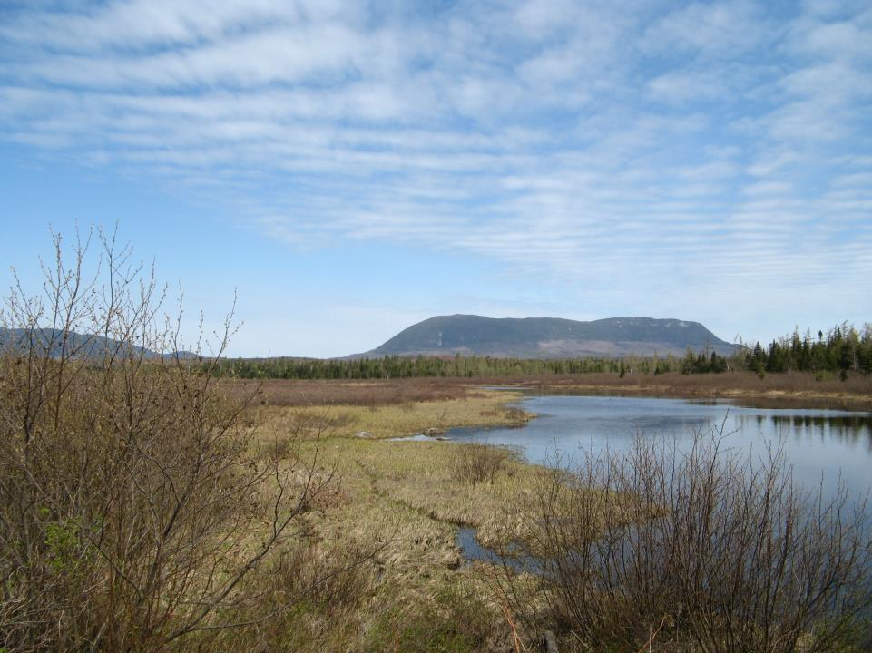
Questions?
andrew.cutko@maine.gov

