Slide 1
Spartina alterniflora and Phragmites australis: Effects of Nutrients, Temperature, and Competition in Mesocosms
Rene Legault M.S. Biological Sciences Candidate, University of New England

Slide 2
Meet The Plants: Spartina alterniflora
(Zottoli 2011)
Notes:
I’m sure many are familiar, but Spartina alterniflora is the dominant low marsh grass.
Tolerant to high salinities and frequent flooding keep it safe (usually) from other competitors.

Slide 3
The Problem – Phragmites australis
(Saltonstall 2010)

Slide 4
Background – Phragmites australis
Phragmites australis is a widespread perennial grass, known as the common reed.
This non-native genotype has exhibited “higher photosynthetic rates, greater biomass production, earlier emergence from rhizomes, higher salt tolerance, and a greater ability to respond to higher nutrients” than its native counterpart (Kettenring & Mock 2012).
Notes:
Phragmites typically grows in dense monocultures, outcompeting neighboring plants in a variety of ways:
Light availability: By growing taller and denser than other salt marsh species
Dense root and rhizome systems: superior allocation of nutrients
Plant litter: Once established, buildup of litter restricts new growth of other species

Slide 5
Phragmites in New England Marshes
Phragmites is abundantly present in New England from roadside ditches, freshwater wetlands, and tidal marshes.
In salt marshes, Phragmites is already well-established in the high marsh zone, outcompeting native plants, such as Spartina patens.
Through establishment in the high marsh, Phragmites can spread vegetatively into the lower zone.

Slide 6
Questions
With sea-level rise forcing low marsh zones to accrete sediments or migrate landward, and Phragmites australis spreading further into low marshes, how does competition affect species diversity within marsh zones?
How do increasing global temperatures affect salt marsh plant species’ growth?
What effect, if any, does increased nutrient loading have on competition between salt marsh plant species?

Slide 7
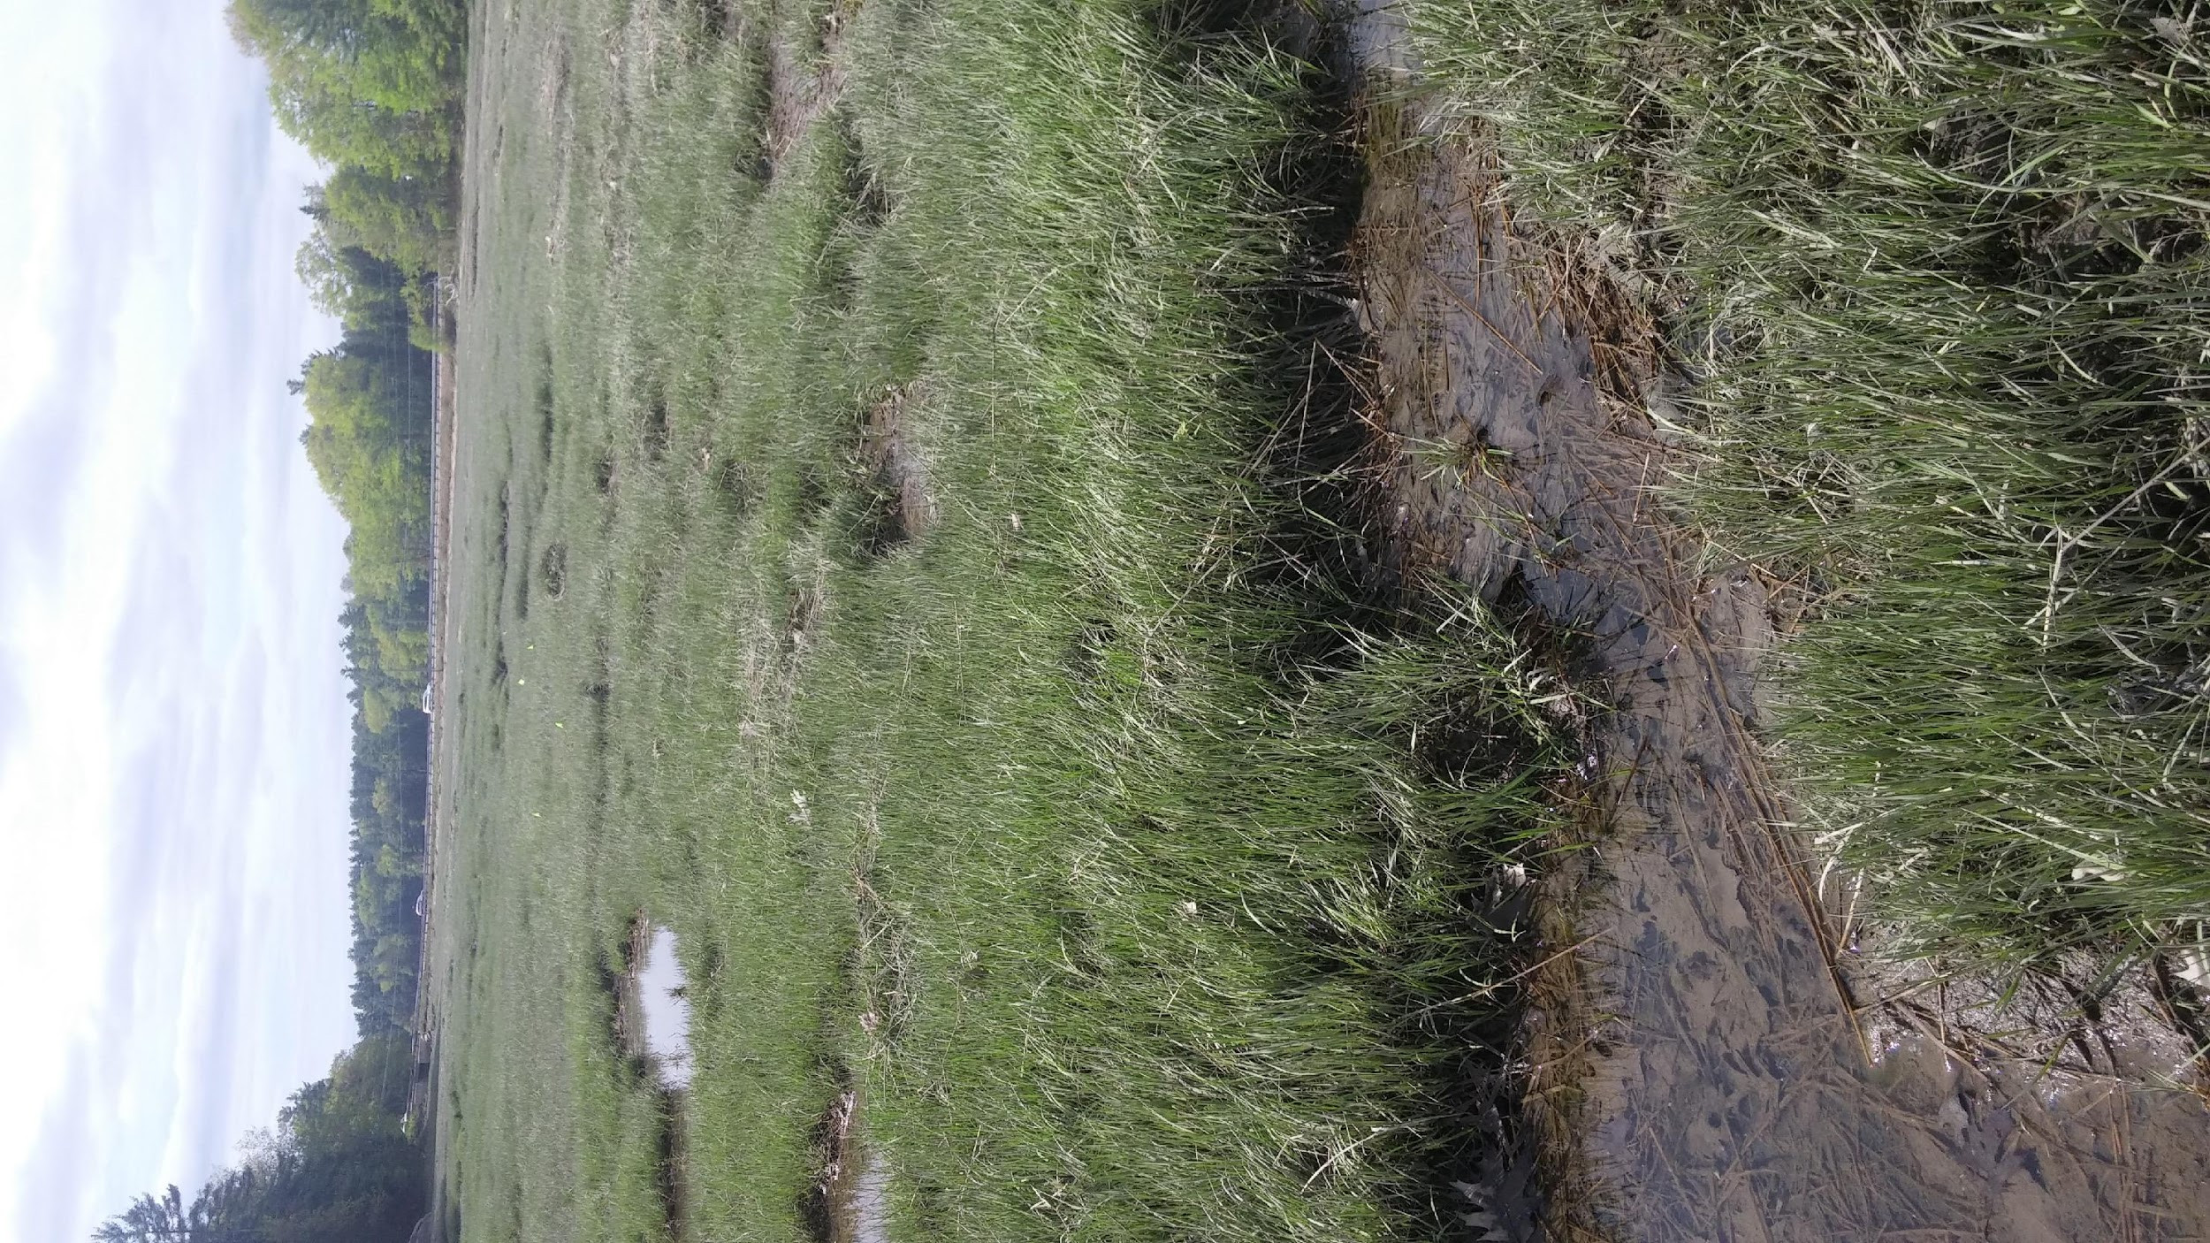
Methods
Plant Collection
Spartina alterniflora – Collected from The Great Bay in New Hampshire
Soil cores with intact stems (n=5) were collected and transplanted into pots (11”D x 24”H).
Phagmites australis – Collected from private land along the Saco River in Saco, Maine.
Soil cores with intact stems (n=1) were collected and transported back to UNE for transplantation into pots.

Slide 8
Mesocosm Design
Plants were placed in pots at three levels of competition (Controls: Spartina, Phragmites, Competition: Spartina x Phragmites)
Pots were placed in bins filled with half strength seawater (salinity ~18ppt).
Water volume in bins was kept constant to assure stable salinity levels.
Nutrients were applied to pots at 3 levels: none (water only), low (30 g N/m²/yr), and high (120 g N/m²/yr).
Greenhouses were built around each bin to simulate increased temperatures, either fully enclosed or open on one side (control).
Temperature and light data loggers were used to monitor these variables over the course of the study.

Slide 9
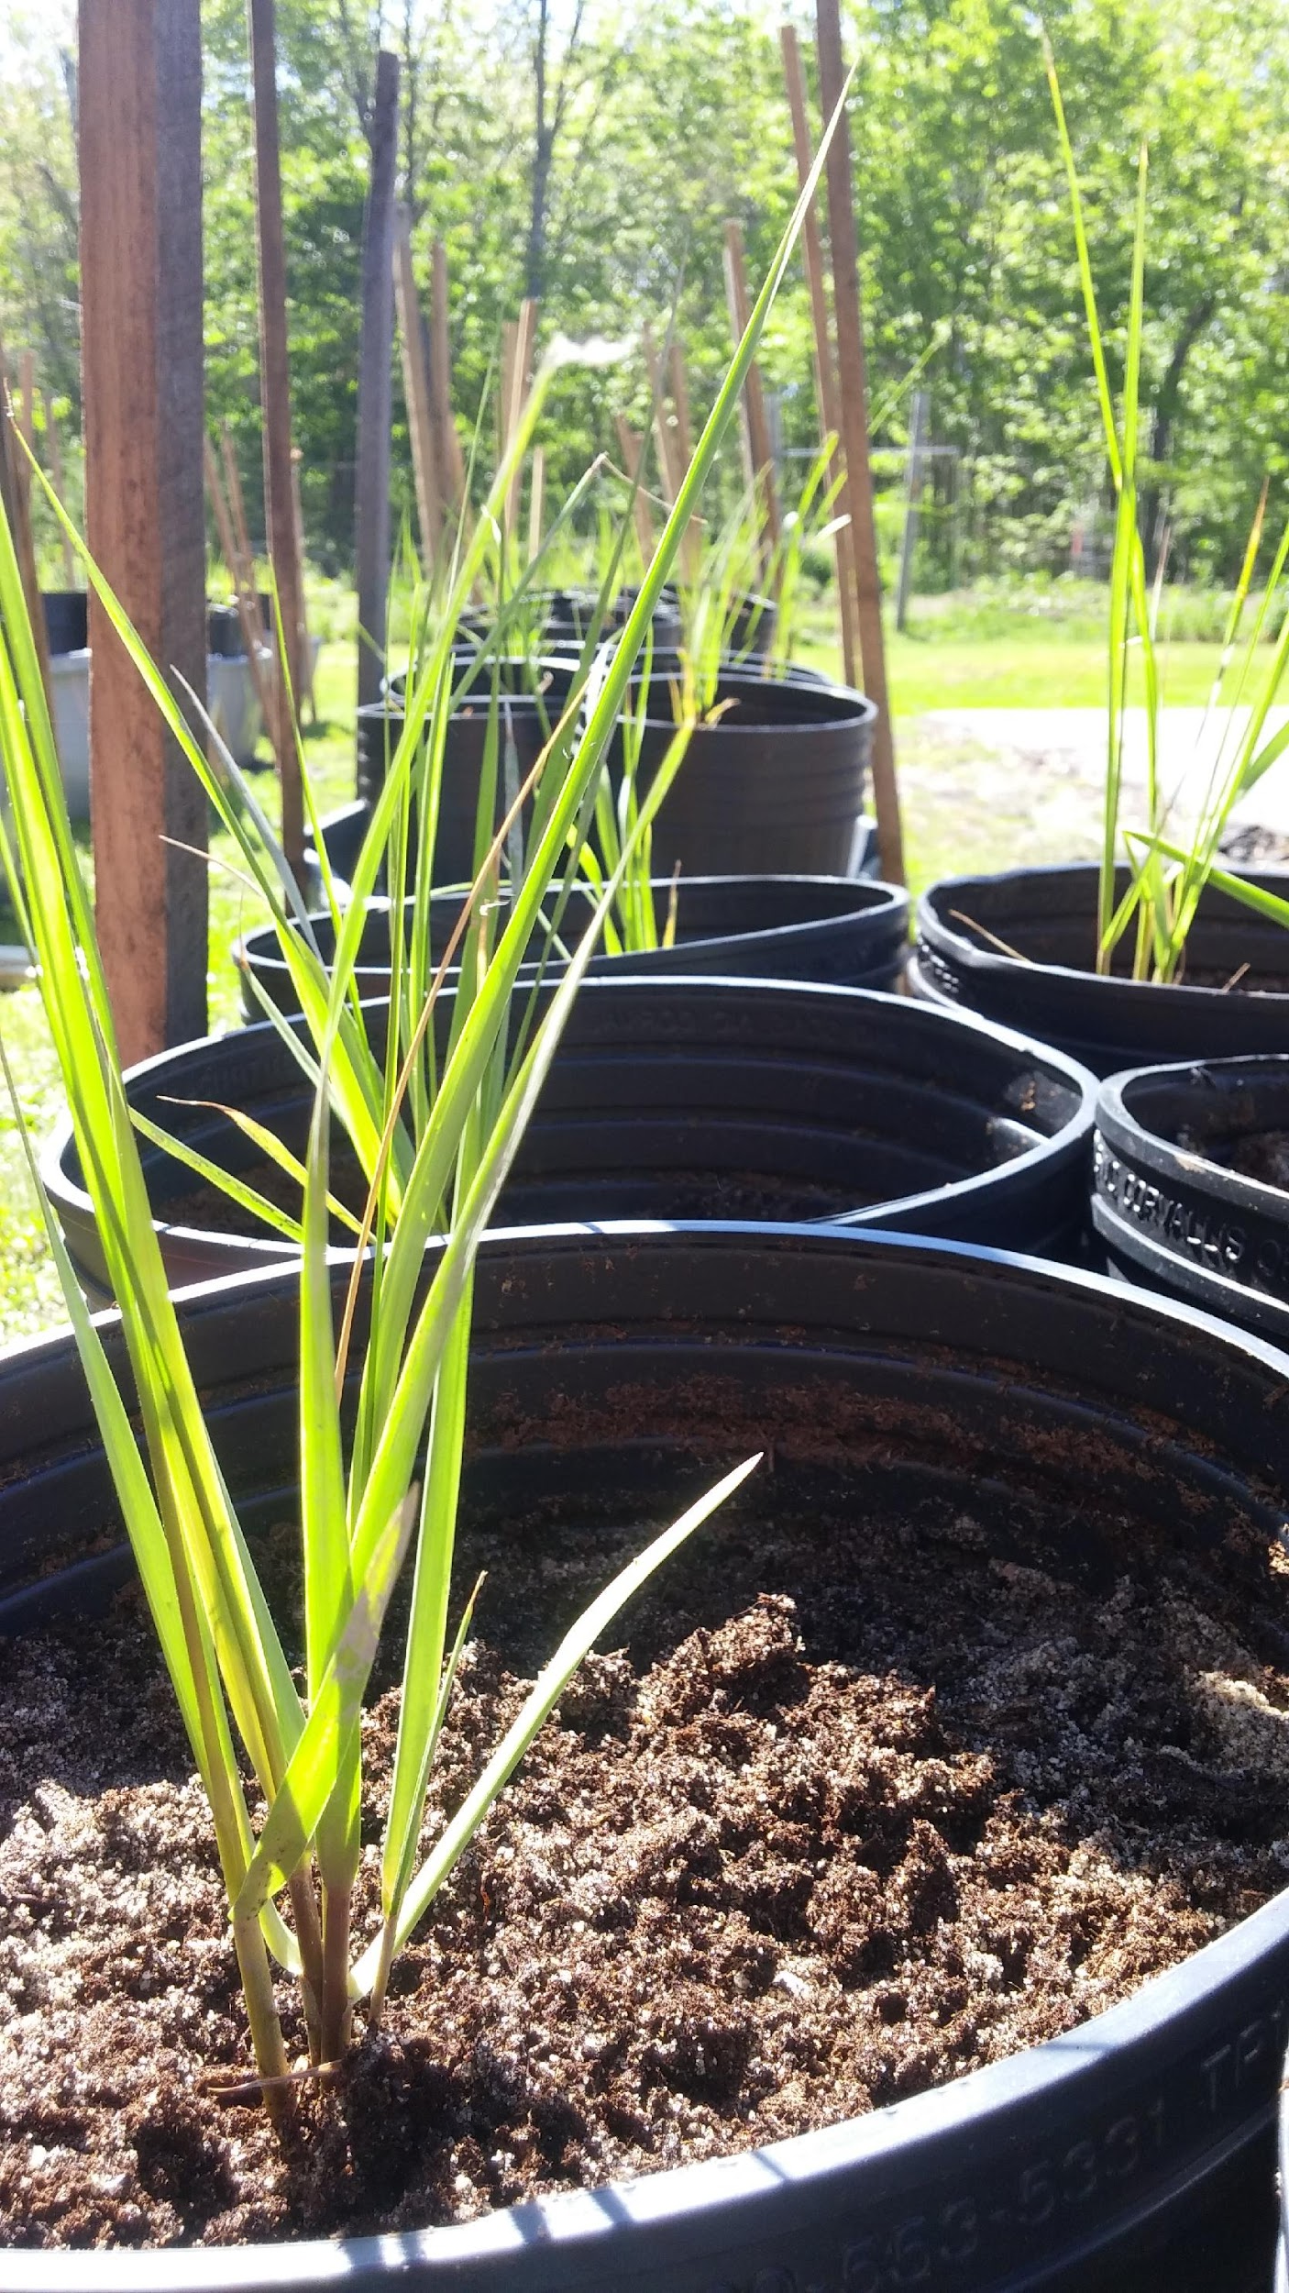
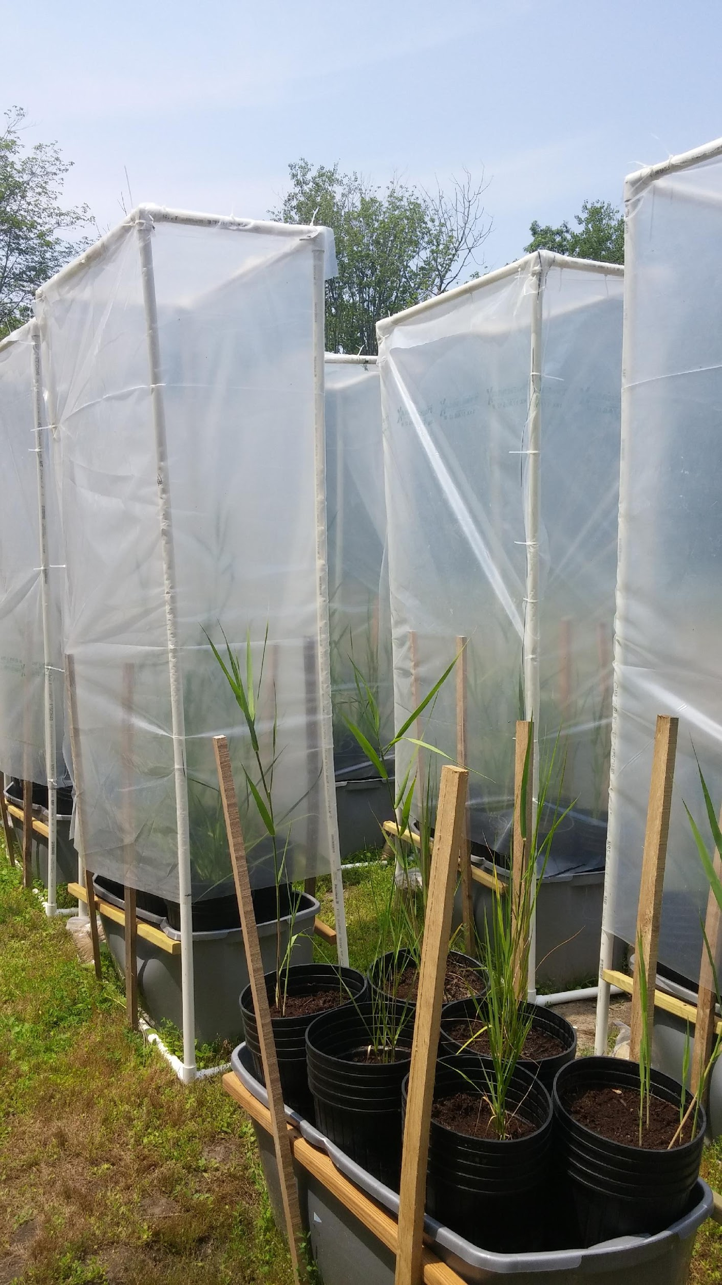

Slide 10
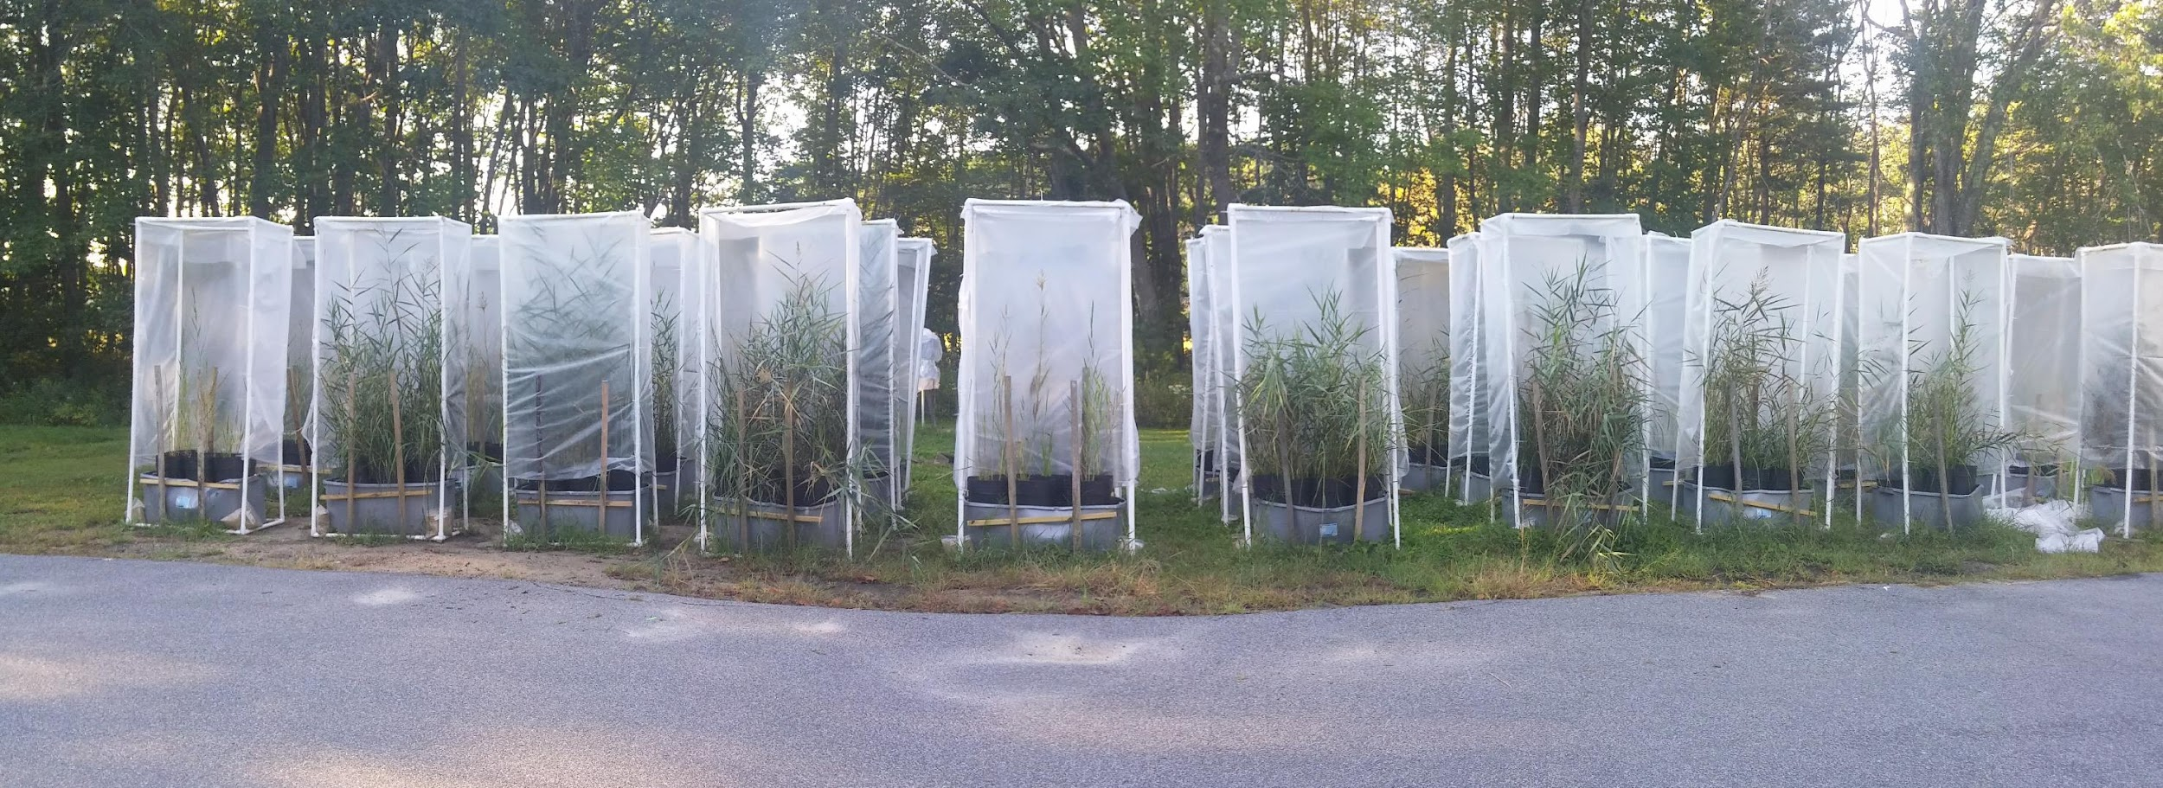

Slide 11
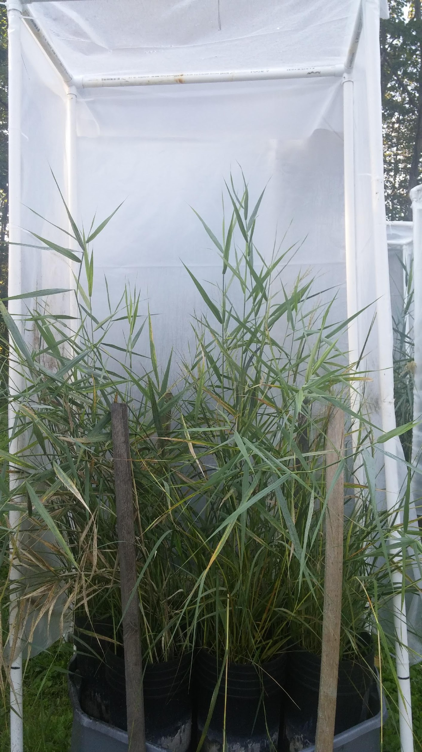
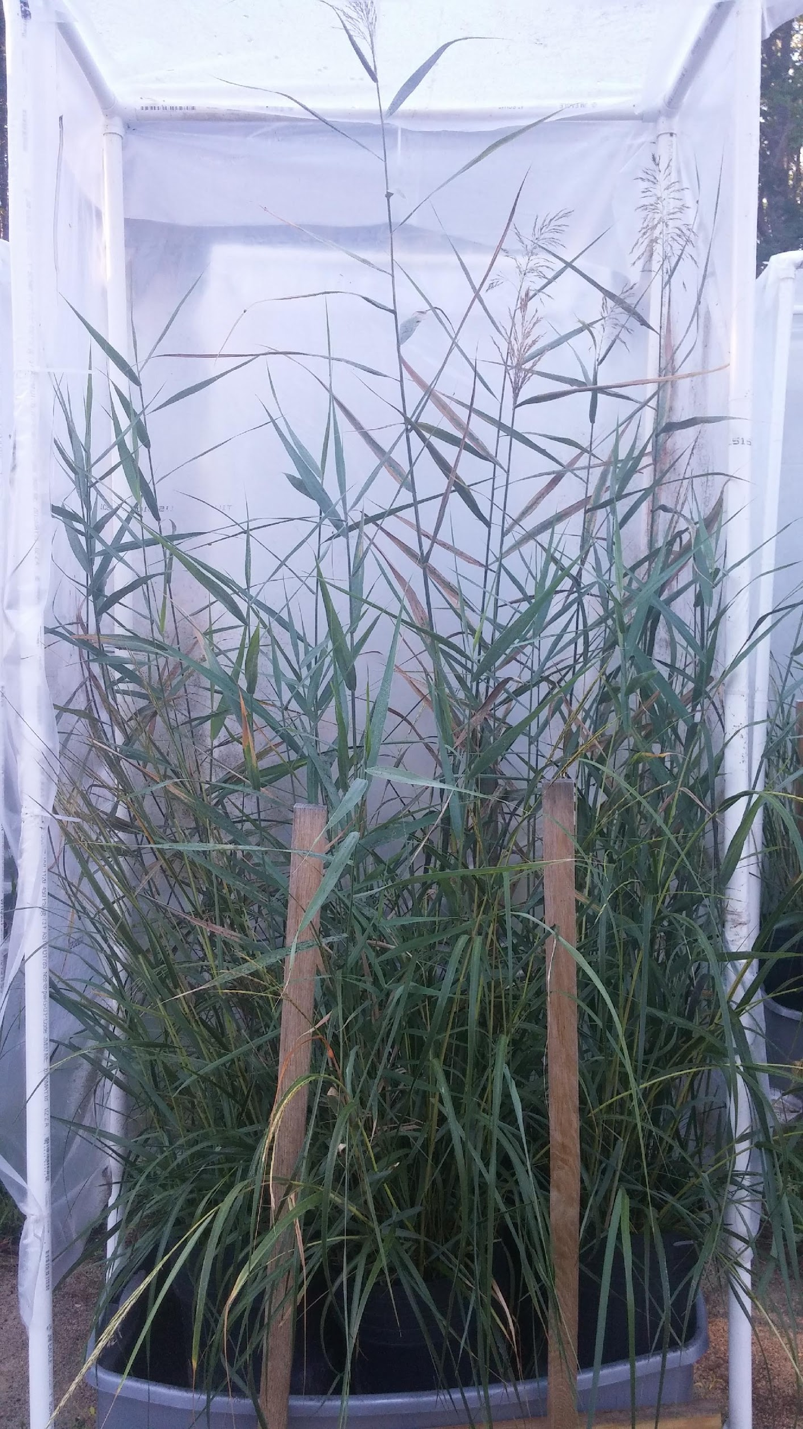
No Nutrients Low Nutrients High Nutrients

Slide 12
Methods – Data Collection/Analysis
Monthly measurements were taken for each pot (n = 180). Individual stems were measured for height and summed across each species for each pot.
Plants were harvested at the end of season and are being analyzed for aboveground biomass.
Analysis: Split-Plot Analysis of Variance using initial stem height as a covariate, measuring plant height as a response to nutrients, competition, and temperature, with both nutrients and temperature as blocking variables.

Slide 13
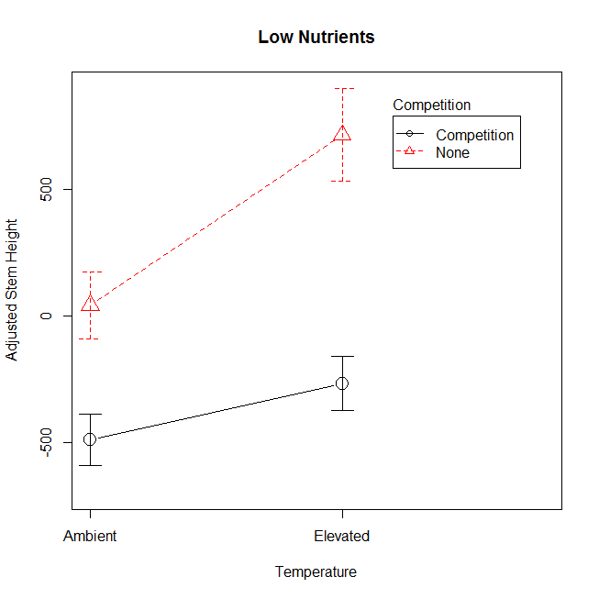
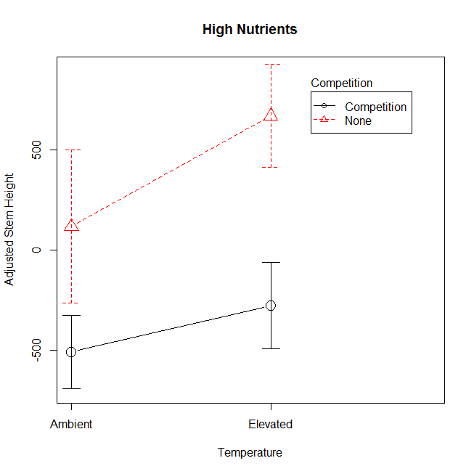
Spartina – End of Season (October)
Significant Effects:
No Comp > Comp (p < 0.05)
No temperature effect
No interaction effect
Significant Effects:
No Comp > Comp (p < 0.001)
Elevated > Ambient (p < 0.01)
No interaction
Significant Effects:
No Comp > Comp (p < 0.01)
No Temperature effect
No interaction effect
Notes:
Here we see how nutrient levels affected the growth of Spartina stems at both conditions of temperature and competition.
The red lines represent stems free of competition, whereas the black lines are stems in competition with Phragmites.
There is clearly an effect of competition, as all of these graphs show higher growth in the stems free of competition,
As well as presence of any nutrients, though low and high seem to have little difference (I believe there will be interesting results in biomass that suggest otherwise).
We also see a dissimilarity in the effects of temperature when nutrients are absent. Increasing temperature actually manages to decrease growth in the absence of nutrients, and this trend is seen in all other months as well!
Lastly, temperature also had an effect on Spartina growth at low nutrients, but not at high nutrients.
The interaction of Temperature and Competition was marginally significant, suggesting some potential combined effects.

Slide 14
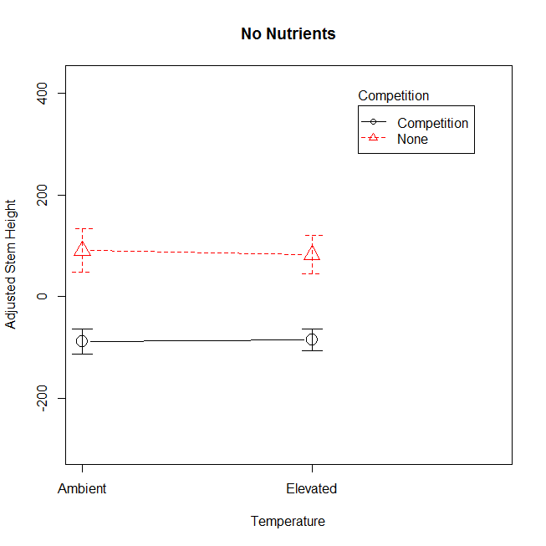
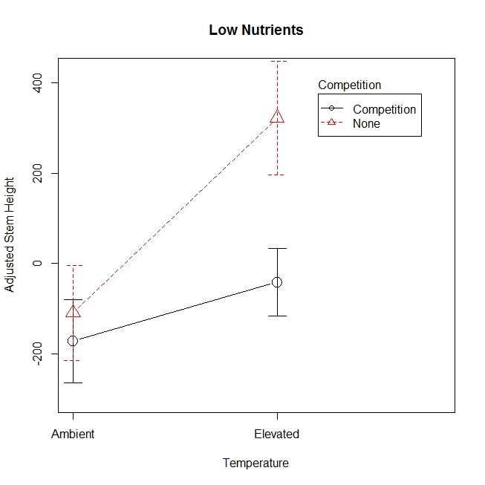
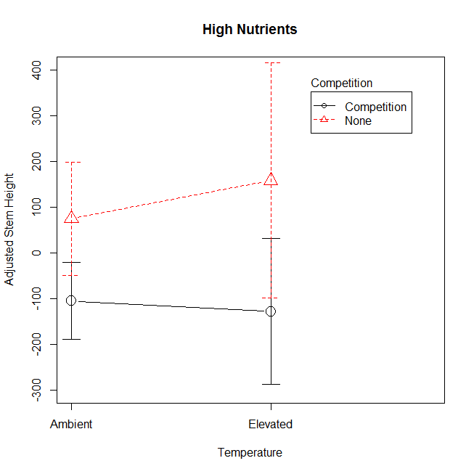
Phragmites – End of Season (October)
Significant Effects:
No Comp > Comp (p < 0.001)
No Temperature effect
No interaction
Significant Effects:
No Comp > Comp (p < 0.05)
No Temperature effect
No interaction
Significant Effects:
No effects
Notes:
Here we see how nutrient levels affected the growth of Phragmites stems at both conditions of temperature and competition.
What is interesting here is that competition affects Phragmites at no and low nutrients, but has no apparent effect on plants under high nutrient loading. This is supported by other months’ measurements except September.
In fact, high nutrient loading removed the effects of any factor in most months, which may speak to the efficacy of non-native Phragmites lineages’ ability to allocate nutrients.
Temperature had no significant effect on Phragmites stems throughout the study, besides this one marginally significant effect under low nutrients (similar to Spartina’s response at low nutrients).
Interactions were only marginally significant as well, as seen here under low nutrient loading.

Slide 15
Conclusions & What’s Next?
Conclusions:
Phragmites’ resilient reputation is well-deserved.
Spartina competition did also affect Phragmites growth at lower nutrient loading levels, suggesting that it may be able to compete and keep its dominance in the low marsh.
Using this information, salt marsh management can be prioritized to differentiate marshes with varying levels of eutrophication as more susceptible to Phragmites invasion, while more natural conditions may (hopefully) favor Spartina alterniflora.
Data from one more growing season will be collected and analyzed to bolster existing results, as well as the addition of belowground biomass to response variables.
Notes:
Many of the factors in this experiment had minimal effects on Phragmites growth when nutrients were present.

Slide 16
References
McCormick MK, Kettenring KM, Baron HM, Whigham DF. 2010. Spread of invasive Phragmites australis in estuaries with differing degrees of development: genetic patterns, Allee effects and interpretation. Journal of Ecology 98: 1369-1378.
Saltonstall K. 2002. Cryptic invasion by a non-native genotype of the common reed, Phragmites australis, into North America. Proceedings of the National Academy of Sciences of the United States of America 99: 2445-2449.
Saltonstall K. 2010. Common Reed. Plant Conservation Alliance’s Alien Plant Working Group [Internet]. Available from: http://www.nps.gov/plants/alien/fact/img/phau1-growing.jpg
Zottoli R. 2011. Salt Water Marshes in Mid-Coast Maine [Internet]. Available from: https://zottoli.wordpress.com/

